Slide 1


Hardware
AUTOMATED GPS BASED SOLAR FERTILIZER SPRAYING MACHINE FOR AGRICULTURE
Shri Vishnu Engineering College For Women
(Autonomous)
Department of Electrical & Electronics Engineering
Project Guide:
M. Siva Rama Ganesh
Assistant Professor
Department of EEE
Project Associates:
Sri Pujitha Veligatla(22B01A0259)

Slide 2
Problem Statement:
Fertilizer spraying in agriculture is still performed manually, making it time-consuming, labor-intensive, and inefficient for large fields. Manual and conventional systems often result in non-uniform fertilizer distribution, increased wastage, and higher operational costs. Existing automated sprayers operate with fixed control logic that requires reprogramming for different land conditions. Additionally, the system does not have a mechanism to identify which areas of the field have already been sprayed, resulting in incomplete or repeated coverage.

Slide 3
Abstract:
Manual fertilizer spraying in agriculture is labor-intensive, time-consuming, and often results in uneven distribution and fertilizer wastage. To overcome these limitations, this project proposes a GPS-based automated solar fertilizer spraying machine that combines renewable energy with automation. The system uses a solar-powered battery supply and an Arduino-based controller to automate movement and spraying operations. The integration of a GPS module enables identification of sprayed areas, ensuring complete and efficient field coverage without repeated application. The proposed system reduces farmers’ workload, minimizes wastage, and offers a sustainable and cost-effective solution for modern agricultural practices.

Slide 4
Objectives of the Work:
To reduce farmers’ time and labour involved in manual spraying.
To ensure uniform and controlled spraying of fertilizers for better crop yield.
To minimize fertilizer wastage and reduce operational costs.
To promote eco-friendly farming practices by using renewable solar energy.
To avoid repeated spraying and missed regions by monitoring the machine’s movement through GPS-based data.
To enable land-independent operation, allowing the system to work on different fields without reprogramming.

Slide 5
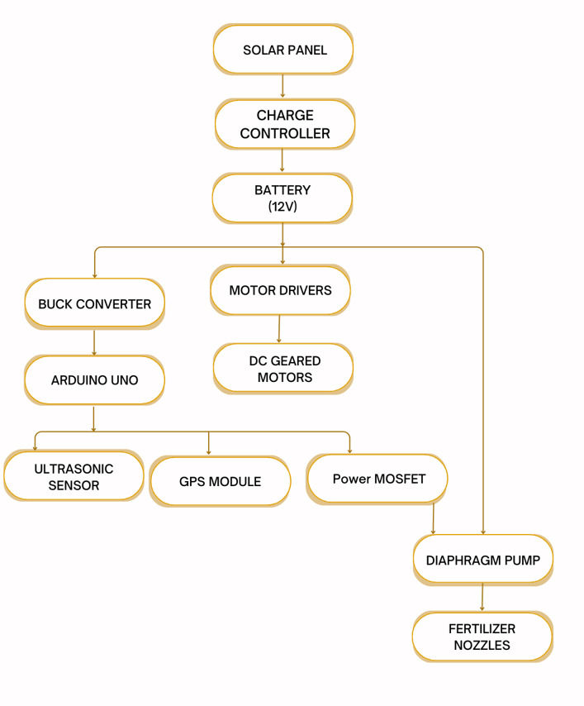
BLOCK DIAGRAM:

Slide 6
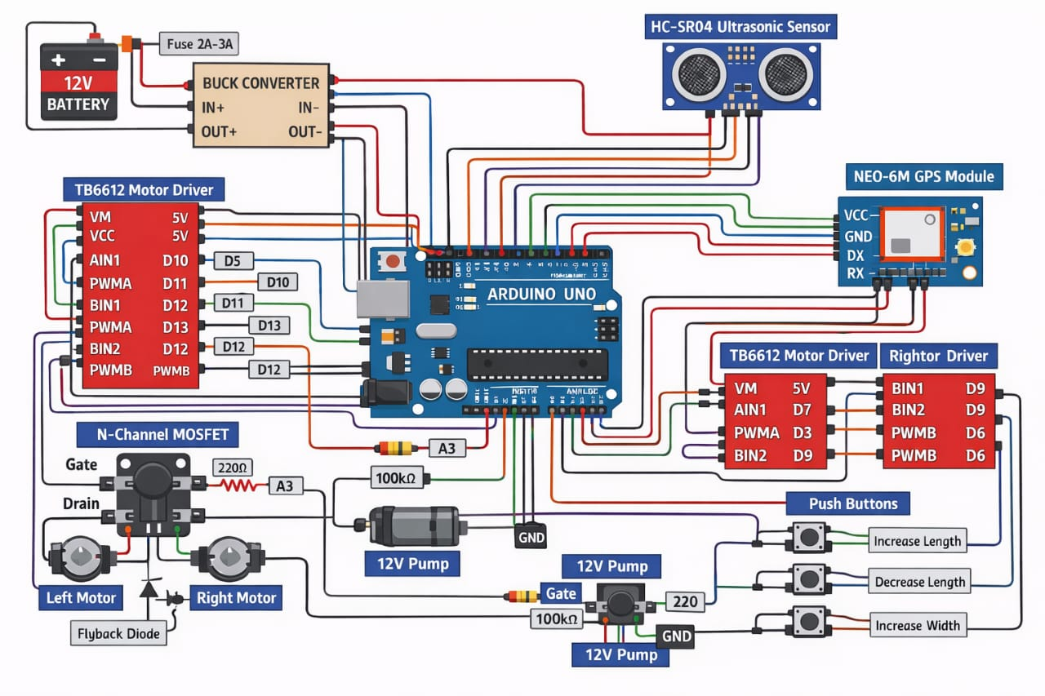
Circuit Diagram:

Slide 7
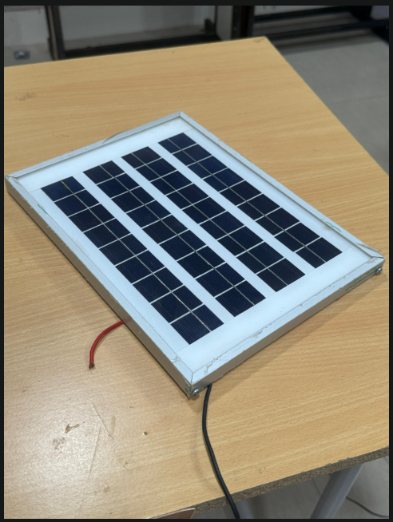
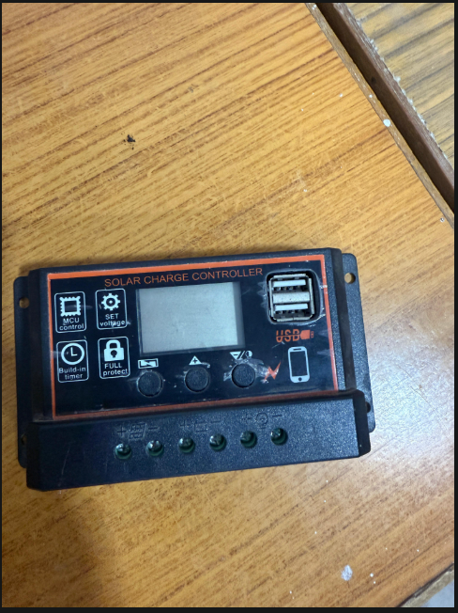
Components List:
Solar Panel:
Converts sunlight into electrical energy using the photovoltaic effect. Supplies power to the charge controller for battery charging.
Charge Controller:
Regulates voltage/current from the solar panel to prevent overcharging or deep discharge of the battery. Ensures safe and efficient charging.

Slide 8
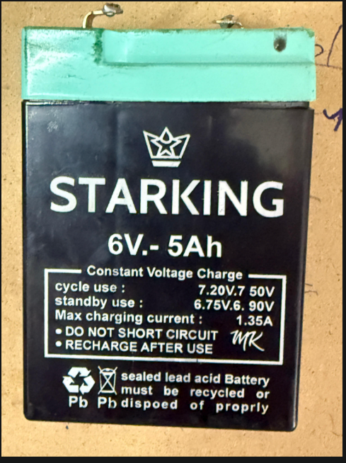
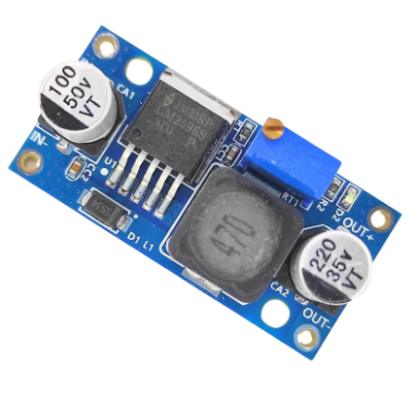
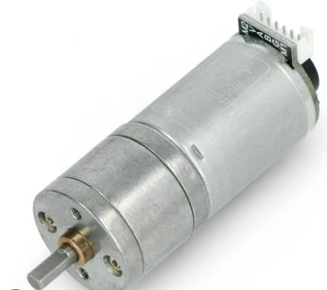
Battery:
Stores electrical energy from the solar panel and provides stable power to the system during operation or low sunlight.
Buck Converter(LM2596):
Steps down the 12V battery voltage to a regulated 5V supply. Powers the Arduino UNO and low-voltage sensors safely.
DC Geared Motors:
Convert electrical energy into mechanical rotation. Provide torque to move the sprayer vehicle’s wheels.

Slide 9
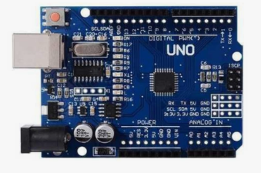
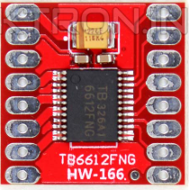
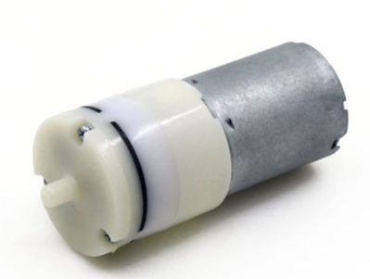
Arduino UNO:
Acts as the brain of the project. Reads inputs from sensors, processes logic, and controls motors and the pump automatically.
TB6612FNG Motor Driver:
Dual H-Bridge driver IC. Receives PWM and direction signals from Arduino and drives the two DC motors for vehicle movement.
Diaphragm pump:
Uses a diaphragm mechanism to push liquid fertilizer under pressure. Controlled by Arduino via MOSFET switching.

Slide 10
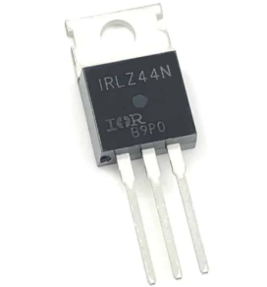
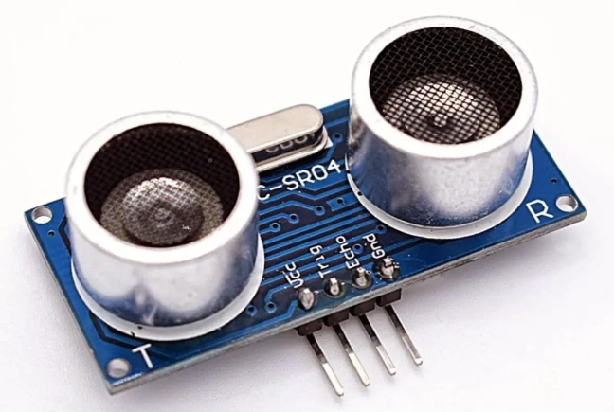
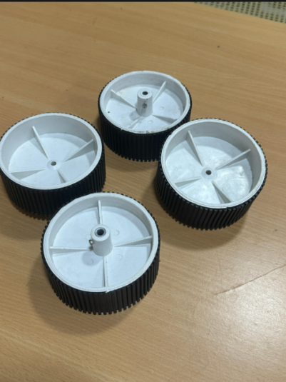
N-channel MOSFET(IRLZ44N):
Works as an electronic switch. Arduino controls its gate to turn the pump ON/OFF and regulate flow with PWM signals.
Ultrasonic sensor:
Measures distance by sending ultrasonic pulses and receiving echoes. Helps the system detect obstacles and avoid collisions.

Slide 11
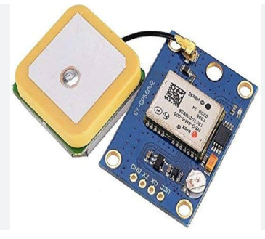
NEO-6M GPS Module:
The GPS module communicates using serial communication and operates independently of the motor control and spraying logic. GPS data is read only for location tracking and coverage identification, not for controlling movement directly.

Slide 12
Project progress overview:
Work Completed :
Designed and implemented an Arduino-based automated solar fertilizer spraying machine for agriculture.
Work in Progress :
Integration of GPS module for location-based field coverage identification.

Slide 13
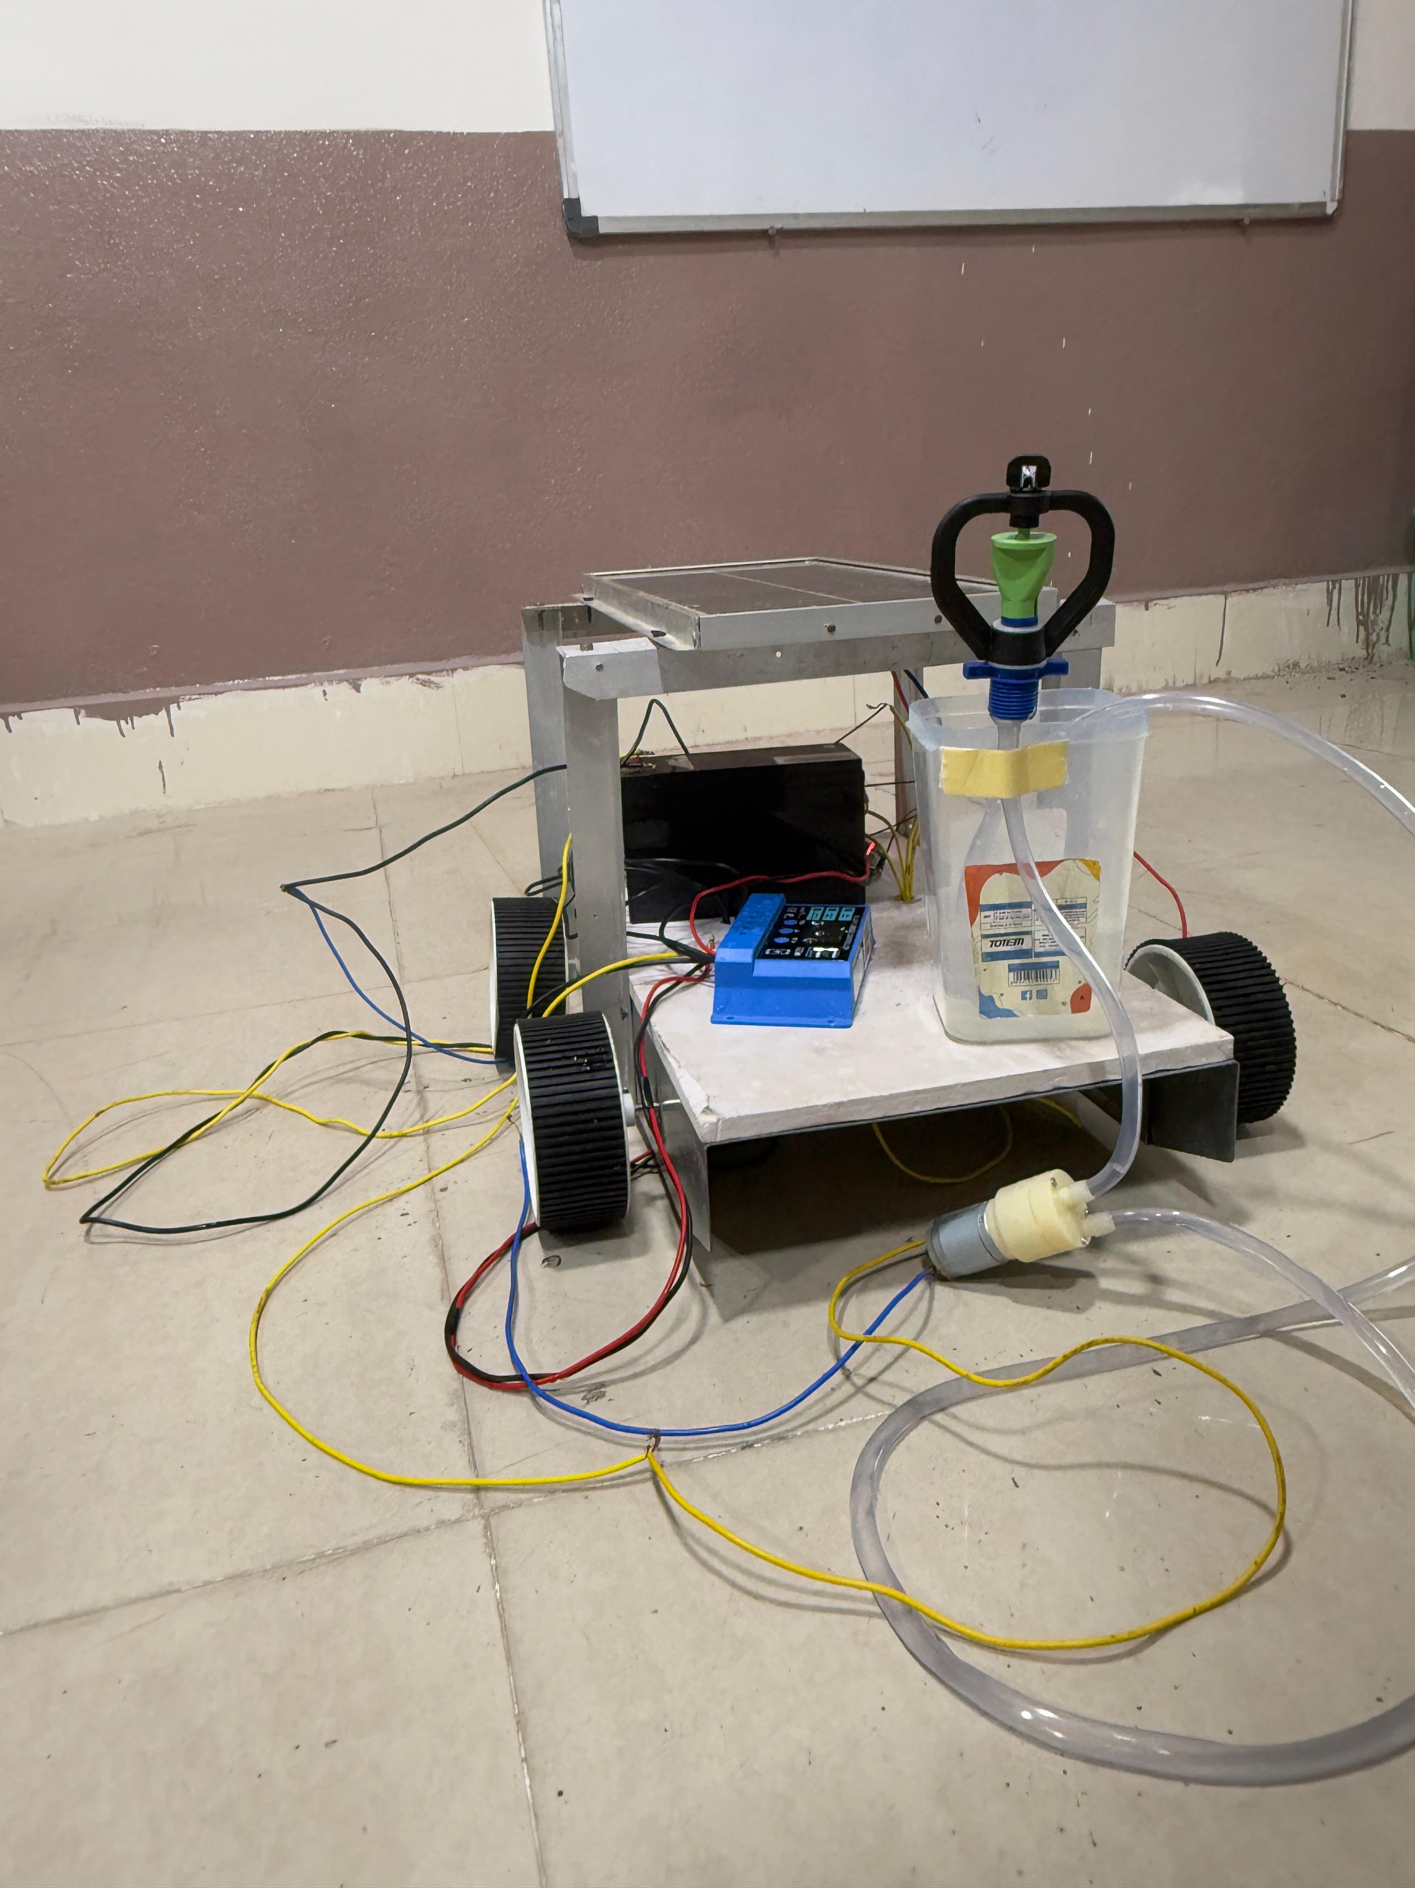
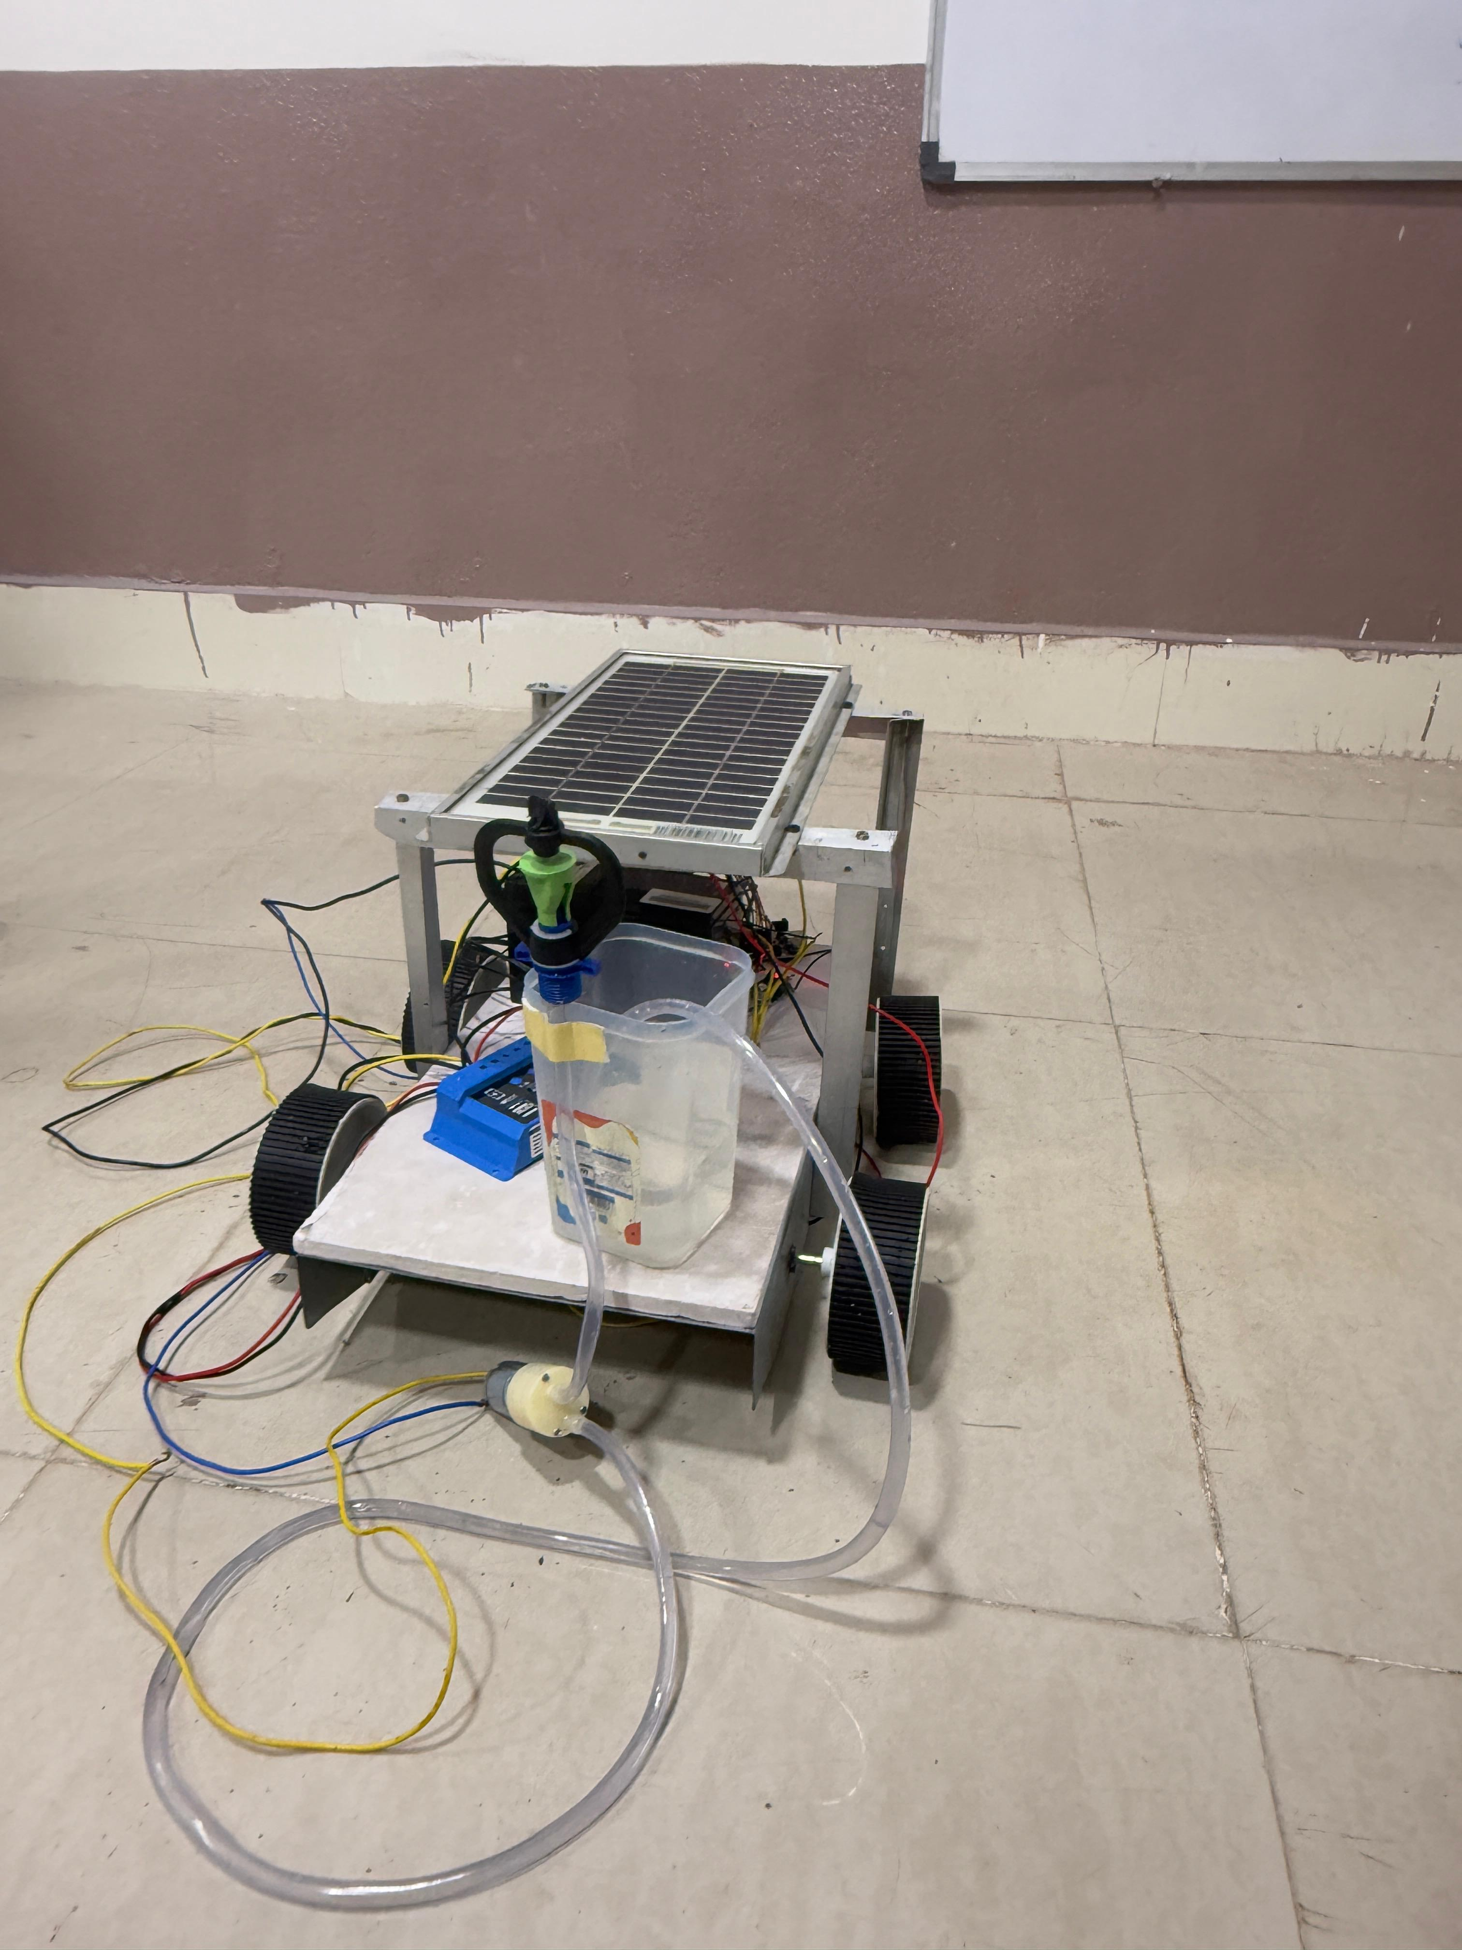
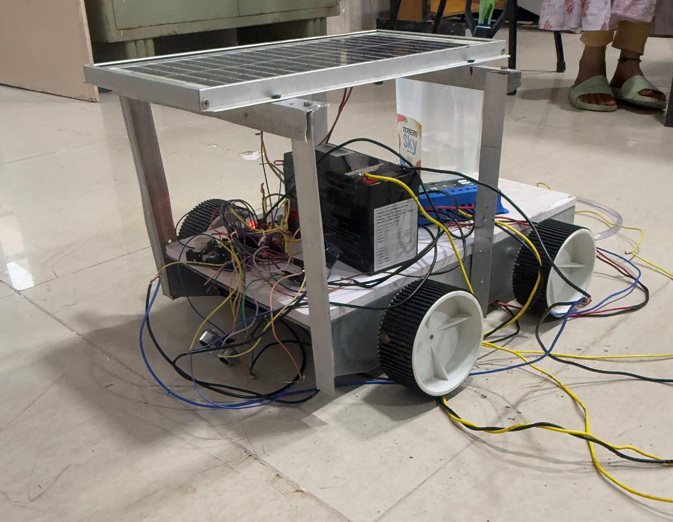
Glimpse of work:

Slide 14
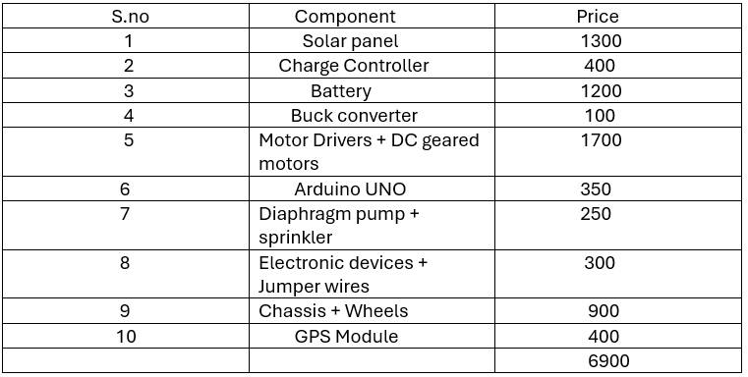
Budget slide:

Slide 15
References:
M. S. Reddy, A. Kumar, and P. Raj, “Design and Development of Solar Powered Pesticide Sprayer,” International Journal of Innovative Research in Electrical, Electronics, Instrumentation and Control Engineering, Vol. 5, Issue 3, March 2017.
P. K. Ramesh, K. V. Reddy, and R. S. Rao, “Development of an Automated Fertilizer Spraying Robot using Arduino Microcontroller,” International Journal of Advanced Research in Electrical, Electronics and Instrumentation Engineering, Vol. 7, Issue 9, September 2018.
D. Patil and S. Deshmukh, “Solar Operated Agricultural Sprayer with Auto Fertilizer Mixing System,” International Journal of Engineering Science and Computing, Vol. 9, Issue 5, May 2019.
S. Mahesh, N. Kumar, and A. Sharma, “IoT Based Smart Agricultural Spraying Vehicle,” Proceedings of 2020 IEEE International Conference on Computing and Communication Technologies (ICCCT),2020.

Slide 16
THANK YOU

